Slide 1
Amazon Reviews Classification
Yue Dai
daiyue@usc.edu

Slide 2
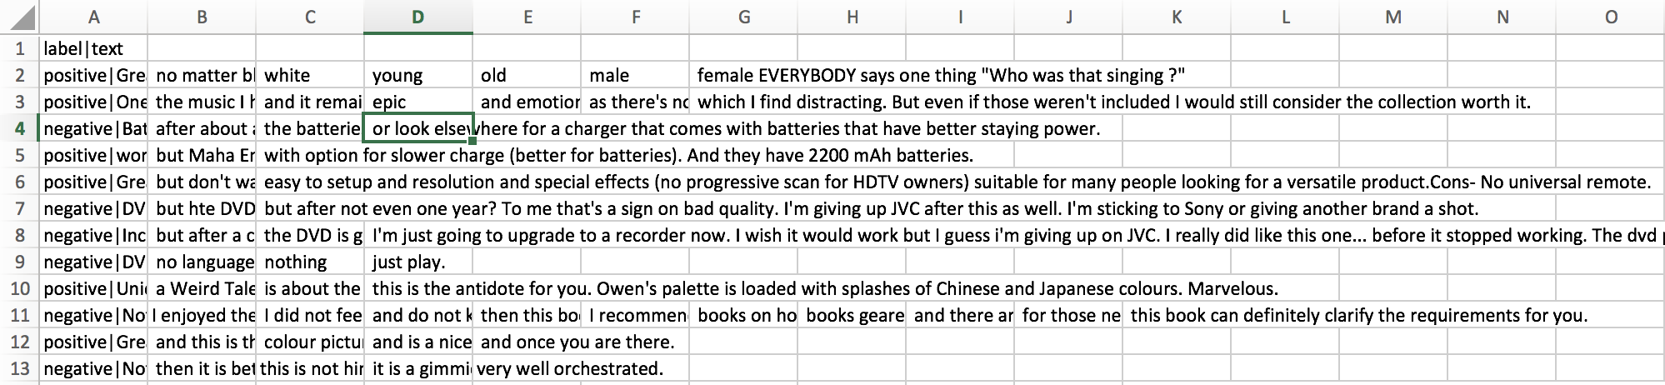
Dataset and pre-processing
The whole dataset is consist of 400,000 reviews of products collected from Amazon. In our program, after trying 4 different datasets with size of 400,000, 100,000, 50,000, and 5000, due to the limit of time and computation space, we randomly pick 50,000 reviews, put every fifth review into the testing set(10,000 reviews), and collect the rest of the reviews to train the system(40,000 reviews)

Slide 3
Dataset and pre-processing
During the pre-processing we uses 6 different ways to get rid of noise data:
Delete stop words;
Extract words from string;
Change words to their stems;
Change words to lowercase;
Delete duplicate words in each review;
Check the spelling and get rid of symbols.
positive|Great CD: My lovely Pat has one of the GREAT voices of her generation. I have listened to this CD for YEARS and I still LOVE IT. When I'm in a good mood it makes me feel better. A bad mood just evaporates like sugar in the rain. This CD just oozes LIFE. Vocals are jusat STUUNNING and lyrics just kill.

Slide 4
Feature extraction
We use the term frequency–inverse document frequency(TF-IDF) method to extract the feature
If we analyzed the reviews in our dataset, we would end up with groups of documents about video', track', lyric', etc. We would gain a large amount of data about the types of reviews that had been written, but would not learn anything about what the users thought of those products.
diminishes the weight of the terms that occur in all the documents of corpus and similarly increases the weight of the terms that occur in rare documents across the corpus;
We reduce the dimension of the features of each reviews
After applying FeatureExtraction to our data, each review has more than 1000 dimensions of feature, which makes it hard to apply classification algorithm to our training data and quiet a long time to train the system. We use DimensionReduce to reduce the dimension of features of reviews to 100.
We have tried 4 different training data with 2 dimensions, 10 dimensions, 100 dimensions and 1000 dimensions, turns out 100 dimensions gives us almost the same accuracy as 1000 dimensions, but it is more efficient than 1000 dimensions.

Slide 5
Classification Algorithms
Decision Tree Algorithm
Easy to Understand: Decision tree output is very easy to understand even for people from non-analytical background.
Useful in Data exploration: Decision tree is one of the fastest way to identify most significant variables and relation between two or more variables.
Less data cleaning required: It requires less data cleaning compared to some other modeling techniques. It is not influenced by outliers and missing values to a fair degree.
Neural Network Algorithm
Can approximate any function, regardless of its linearity
Great for complex/abstract problems like image recognition
Neural network models require less ford statistical training to develop
Support Vector Machine Algorithm
SVM is a linear learning method that finds an optimal hyperplane to separate two classes
SVMs are a machine learning classification technique which use a function called a kernel to map a space of data points in which the data is not linearly separable onto a new space.
SVM have been proven as one of the most powerful learning algorithms for text categorization

Slide 6
Results and comparison
 | Decision Tree |  | Neural Network |  | Support Vector Machine
 | Positive | Negative | Positive | Negative | Positive | Negative
Precision | 0.798001 | 0.745894 | 0.77852 | 0.823767 | 0.80097 | 0.82045
Recall | 0.748419 | 0.806162 | 0.845852 | 0.749643 | 0.835066 | 0.784126

Slide 7
Decision Tree ROC
Negative
Positive

Slide 8
Neural Network ROC
Negative
Positive

Slide 9
Support Vector Machine ROC
Negative
Positive

